Slide 1
Pointer for Inter-function Communication
One of the most useful applications of pointers is in functions, C uses the pass-by-value for downward communication and the pass-by-address for upward communication.

Slide 2
An Unworkable Exchange

Slide 3
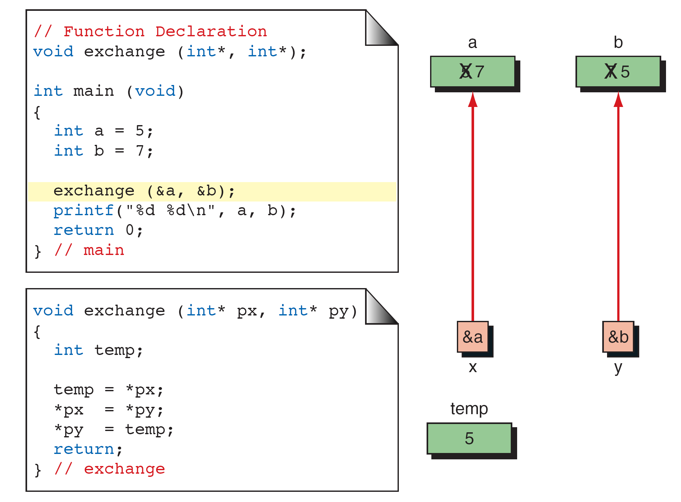
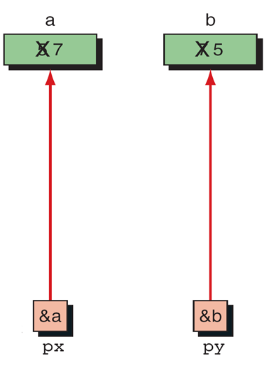
Exchange Using Pointers

Slide 4
Note
Every time we want a called function to have access to a variable in the calling function, we pass the address
of that variable to the called function and use
the indirection operator to access it.

Slide 5
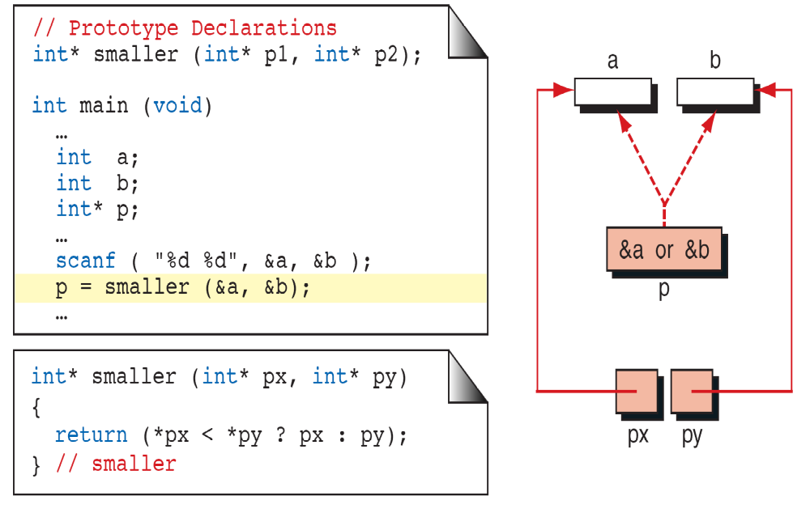
Functions Returning Pointers

Slide 6
Pointers to Pointers
So far, all our pointers have been pointing directly to
data.
It is also possible that a pointer point to other pointers.
For example, we can have a pointer pointing to a
pointer to an integer.

Slide 7
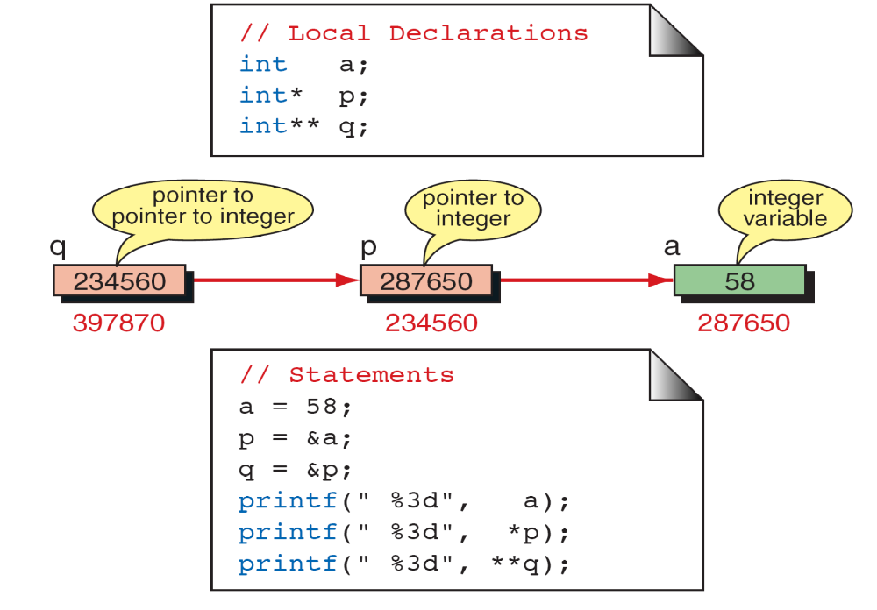
Pointers to Pointers

Slide 8
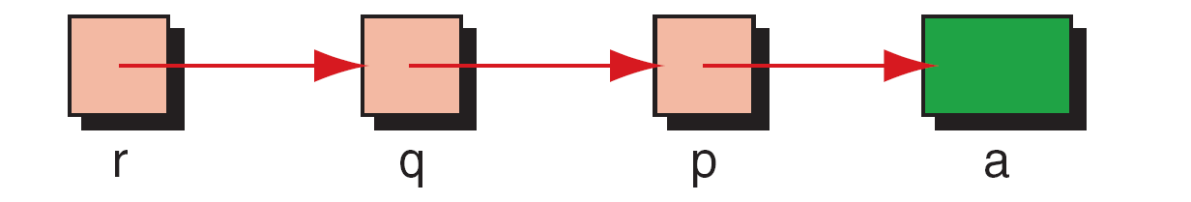
Using Pointers to Pointers

Slide 9
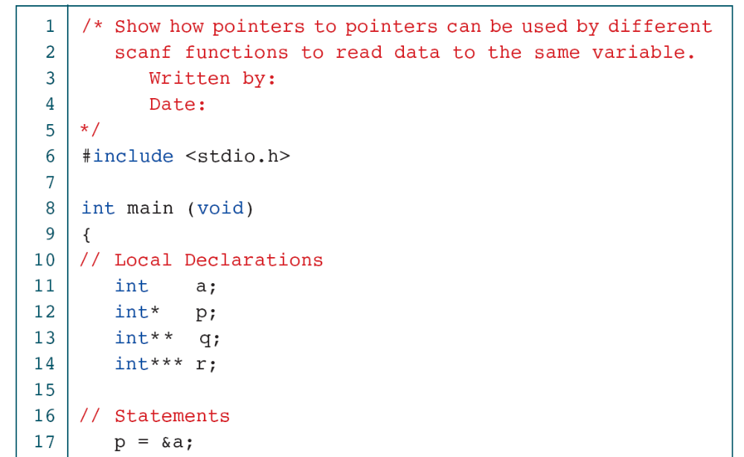
Using pointers to pointers

Slide 10
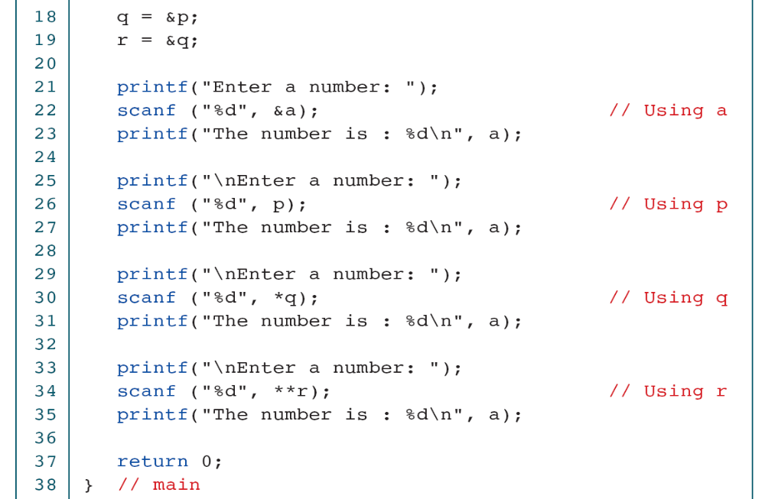
Using pointers to pointers

Slide 11
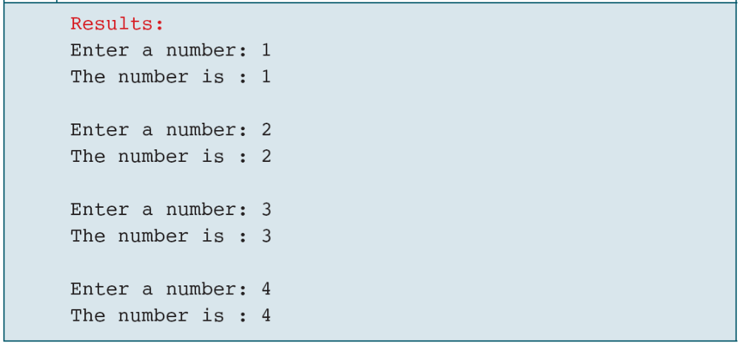
Using pointers to pointers

Slide 12
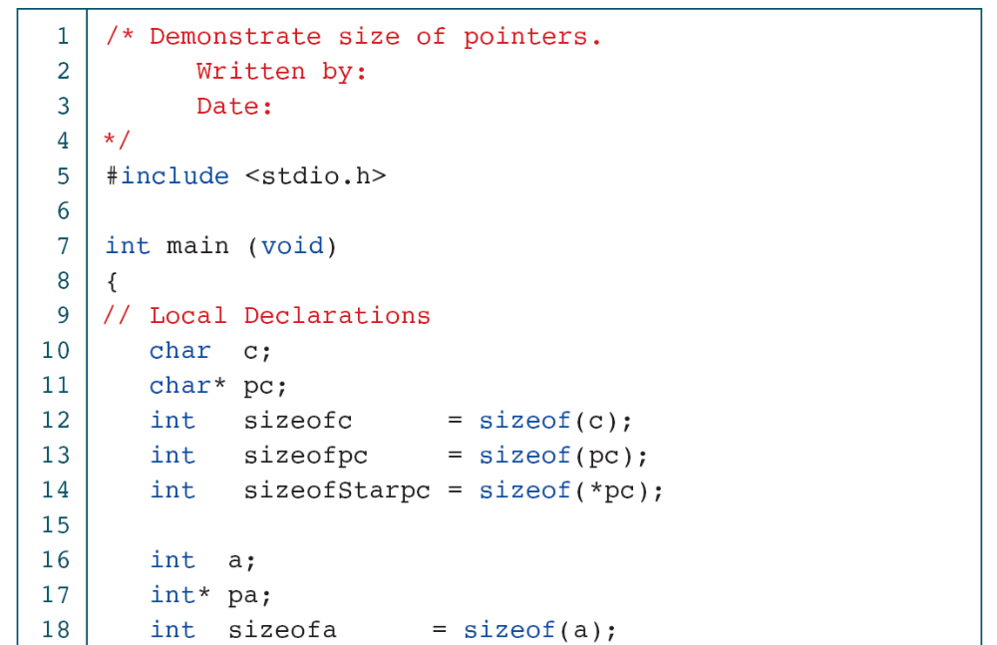
Demonstrate Size of Pointers

Slide 13
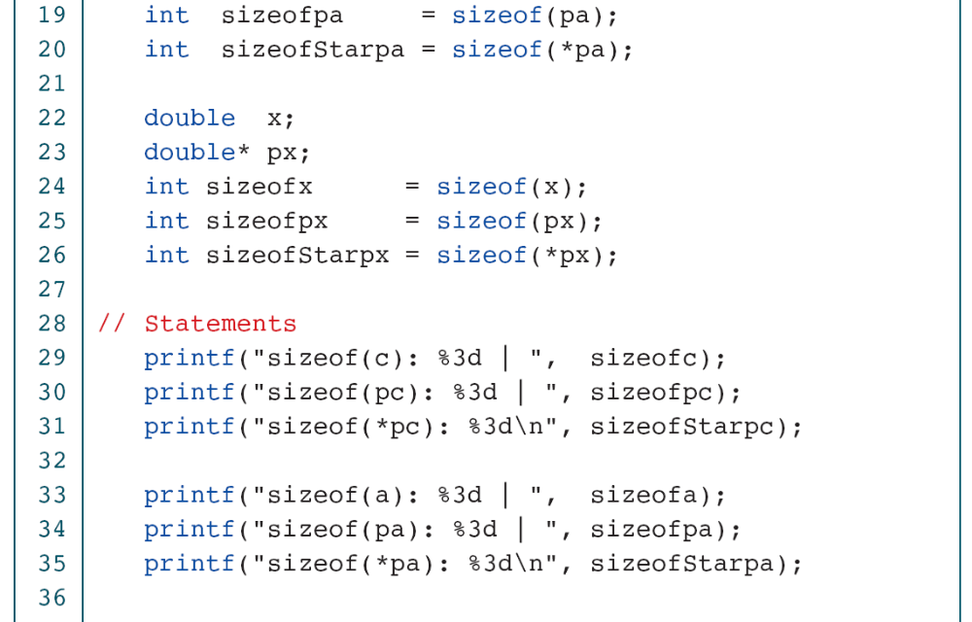
Demonstrate Size of Pointers

Slide 14
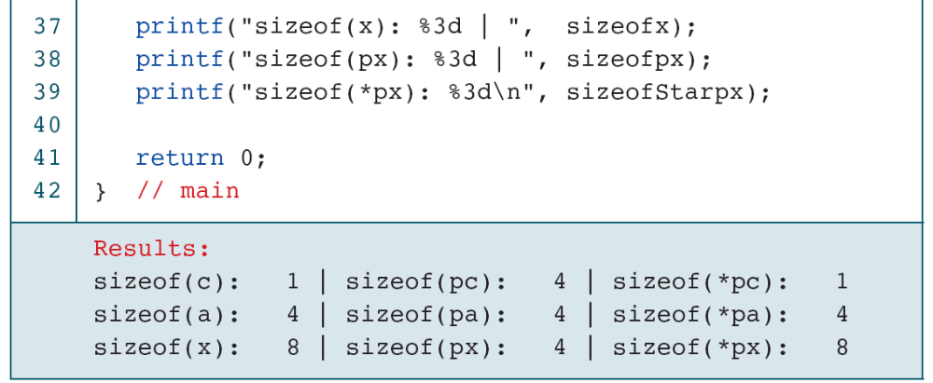
Demonstrate Size of Pointers

Slide 15
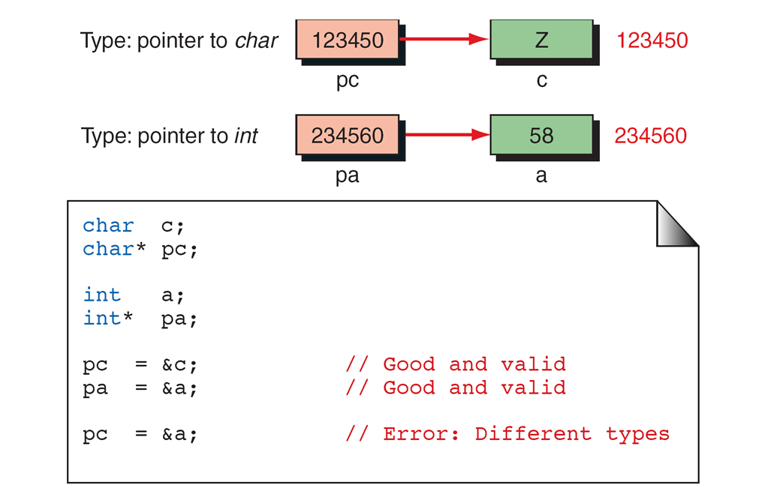
Dereference Type Compatibility

Slide 16
Note
A void pointer cannot be dereferenced.
When several values need to be sent back to the calling function, use address parameters for all of them.
Do not return one value and use address
Parameters for the others.

